Slide 1

MySQL: Introduction and Tools

Slide 2
Connecting to MySQL Using the MySQL Client
Connecting to the Server
Authentication and Access
The MySQL client offers a command-line interface for interacting with MySQL databases. You can connect using the 'mysql' command, providing your server details, username, and password.
Upon connecting, the client verifies your credentials and grants you access to the database. This ensures only authorized users can interact with the database.

Slide 3

Navigating the MySQL Client Interface
Database Selection
Command Execution
The MySQL client allows you to switch between databases using the 'USE' command. This command specifies the database you want to work with.
You can execute SQL queries using the 'mysql' command prompt. The client processes your commands and displays the results, helping you manage your data.
Interactive Experience
The MySQL client provides a direct, interactive way to manage your database. You can issue commands, view results, and monitor your database in real-time.

Slide 4

Executing SQL Queries in the MySQL Client
1
Data Retrieval
2
Data Manipulation
3
Data Definition
Use 'SELECT' queries to retrieve data from tables. Specify the columns and conditions to select the desired data.
Use 'INSERT', 'UPDATE', and 'DELETE' queries to modify the database. These commands allow you to add, change, or remove data in your tables.
Use 'CREATE', 'ALTER', and 'DROP' commands to manage the structure of your database. You can create new tables, modify existing ones, or remove tables entirely.

Slide 5




Importing and Exporting Data Using the MySQL Client
Data Import
Data Export
Data Transfer
Use the 'LOAD DATA INFILE' command to import data from external files into your MySQL database. You can import data from various formats, such as CSV or SQL files.
Use the 'SELECT...INTO OUTFILE' command to export data from your MySQL database to external files. You can export data in various formats, such as CSV or SQL files.
The client provides tools for moving data between different parts of your database, including different tables and databases. You can efficiently transfer data based on specific criteria.

Slide 6
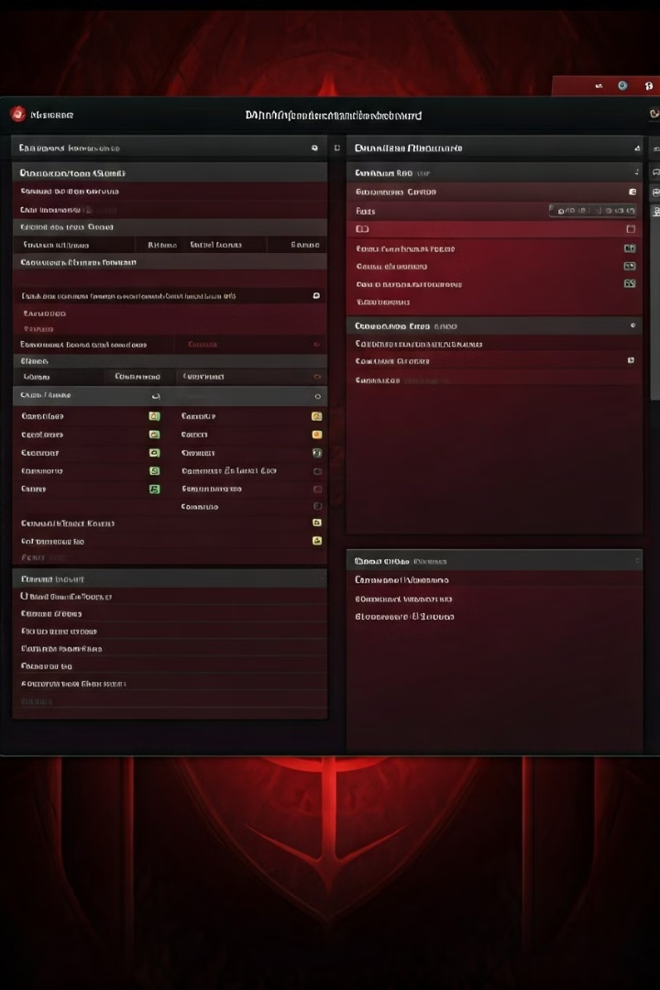



Introduction to phpMyAdmin
Web-Based Administration
phpMyAdmin is a web-based tool that provides a graphical interface for managing MySQL databases. It offers a user-friendly alternative to the command-line interface.
Intuitive Interface
The tool features a clear and intuitive interface, making it easy for both beginners and experienced users to navigate and perform database operations.
Enhanced Functionality
phpMyAdmin provides a wide range of features for managing databases, including creating and deleting databases, managing users and permissions, and performing SQL queries.

Slide 7

Connecting to MySQL Using phpMyAdmin
1
Server Configuration
You need to configure phpMyAdmin with the address of your MySQL server, your username, and your password to establish a connection.
2
Authentication
phpMyAdmin authenticates you against the MySQL server using your credentials, granting access to the databases you are authorized to manage.
3
Dashboard Access
Once successfully authenticated, you are granted access to the phpMyAdmin dashboard, where you can manage your databases, tables, and data.

Slide 8
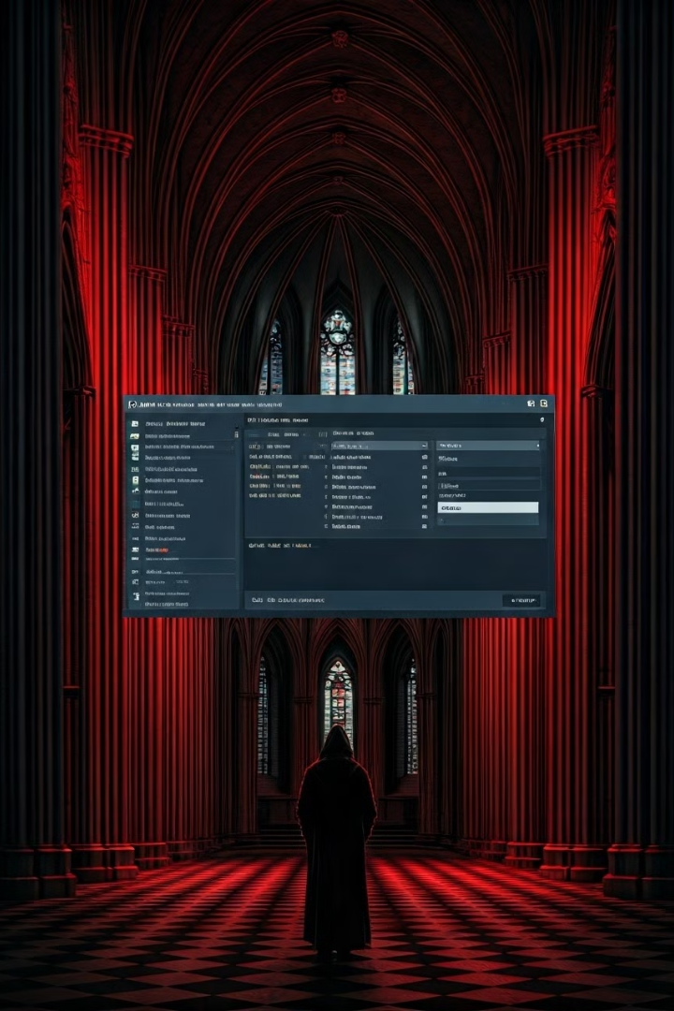
Exploring and Managing Databases with phpMyAdmin
**Feature**
**Description**
Database Management
Create, delete, and rename databases. Manage user accounts and permissions.
Table Management
Create, edit, and delete tables. Define columns, data types, and relationships.
Data Manipulation
Insert, update, and delete data within tables. Browse and search data.
Query Execution
Execute SQL queries and view results. Manage database backups and restores.

